Slide 1

AI Workshop
By Muhamad Nur Rohman
Day 5
July 13, 2022

Slide 2
Topics
1. Dataset pre-processing | : | Normalization (input and output) | Day 1
 |  | Randomization (shuffle)
 |  | Dataset division (training, validation, and testing)
 |  | Dataset division using cross validation
2. Variable importance analysis | : | Random forest | Day 1
3. AI-based modeling | : | Support vector machine (SVM/SVR) | Day 2
 |  | Random forest for classification/regression
 |  | ANN/DNN
4. Metaheuristic optimization | : | Particle swarm optimization (PSO) | Day 3
5. Hybrid AI-based model – metaheuristic optimization (Hyperparameter tuning) | : | SVR-PSO ANN-PSO DNN-PSO ANN/DNN fine-tuning | Day 4
6. Optimization using machine learning model | : | PSO-SVR | Day 5
7. Object measurement | : | Computer vision / OpenCV | Day 6

Slide 3
Optimization using machine learning model PSO-SVR
Example
We want to find the combination of machining parameters (depth of cut, feed rate, and insert radius) for the optimal surface roughness.
Use PSO to optimize the machining process parameters
Optimal combination of machining process parameters
Conduct experiment
Develop a model

Slide 4
X_{i,j} = LB_{j} + rand(0,1)*(UB_{j}-LB_{j})
Population initialization
Particles: depth of cut, feed rate, and insert radius
Evaluate the fitness
Save the Pbest and Gbest
Minimize the surface roughness
Use SVR model to predict the surface roughness
Update the rate and position
filename = 'SVR_model_fold3.sav'
model = pickle.load(open(filename, 'rb'))
y_pred = model.predict(X)
Boundary handling
N
Stopping criteria satisfied?
Optimal surface roughness
Y
Optimal depth of cut, feed rate, and insert radius
Optimal solution

Slide 5
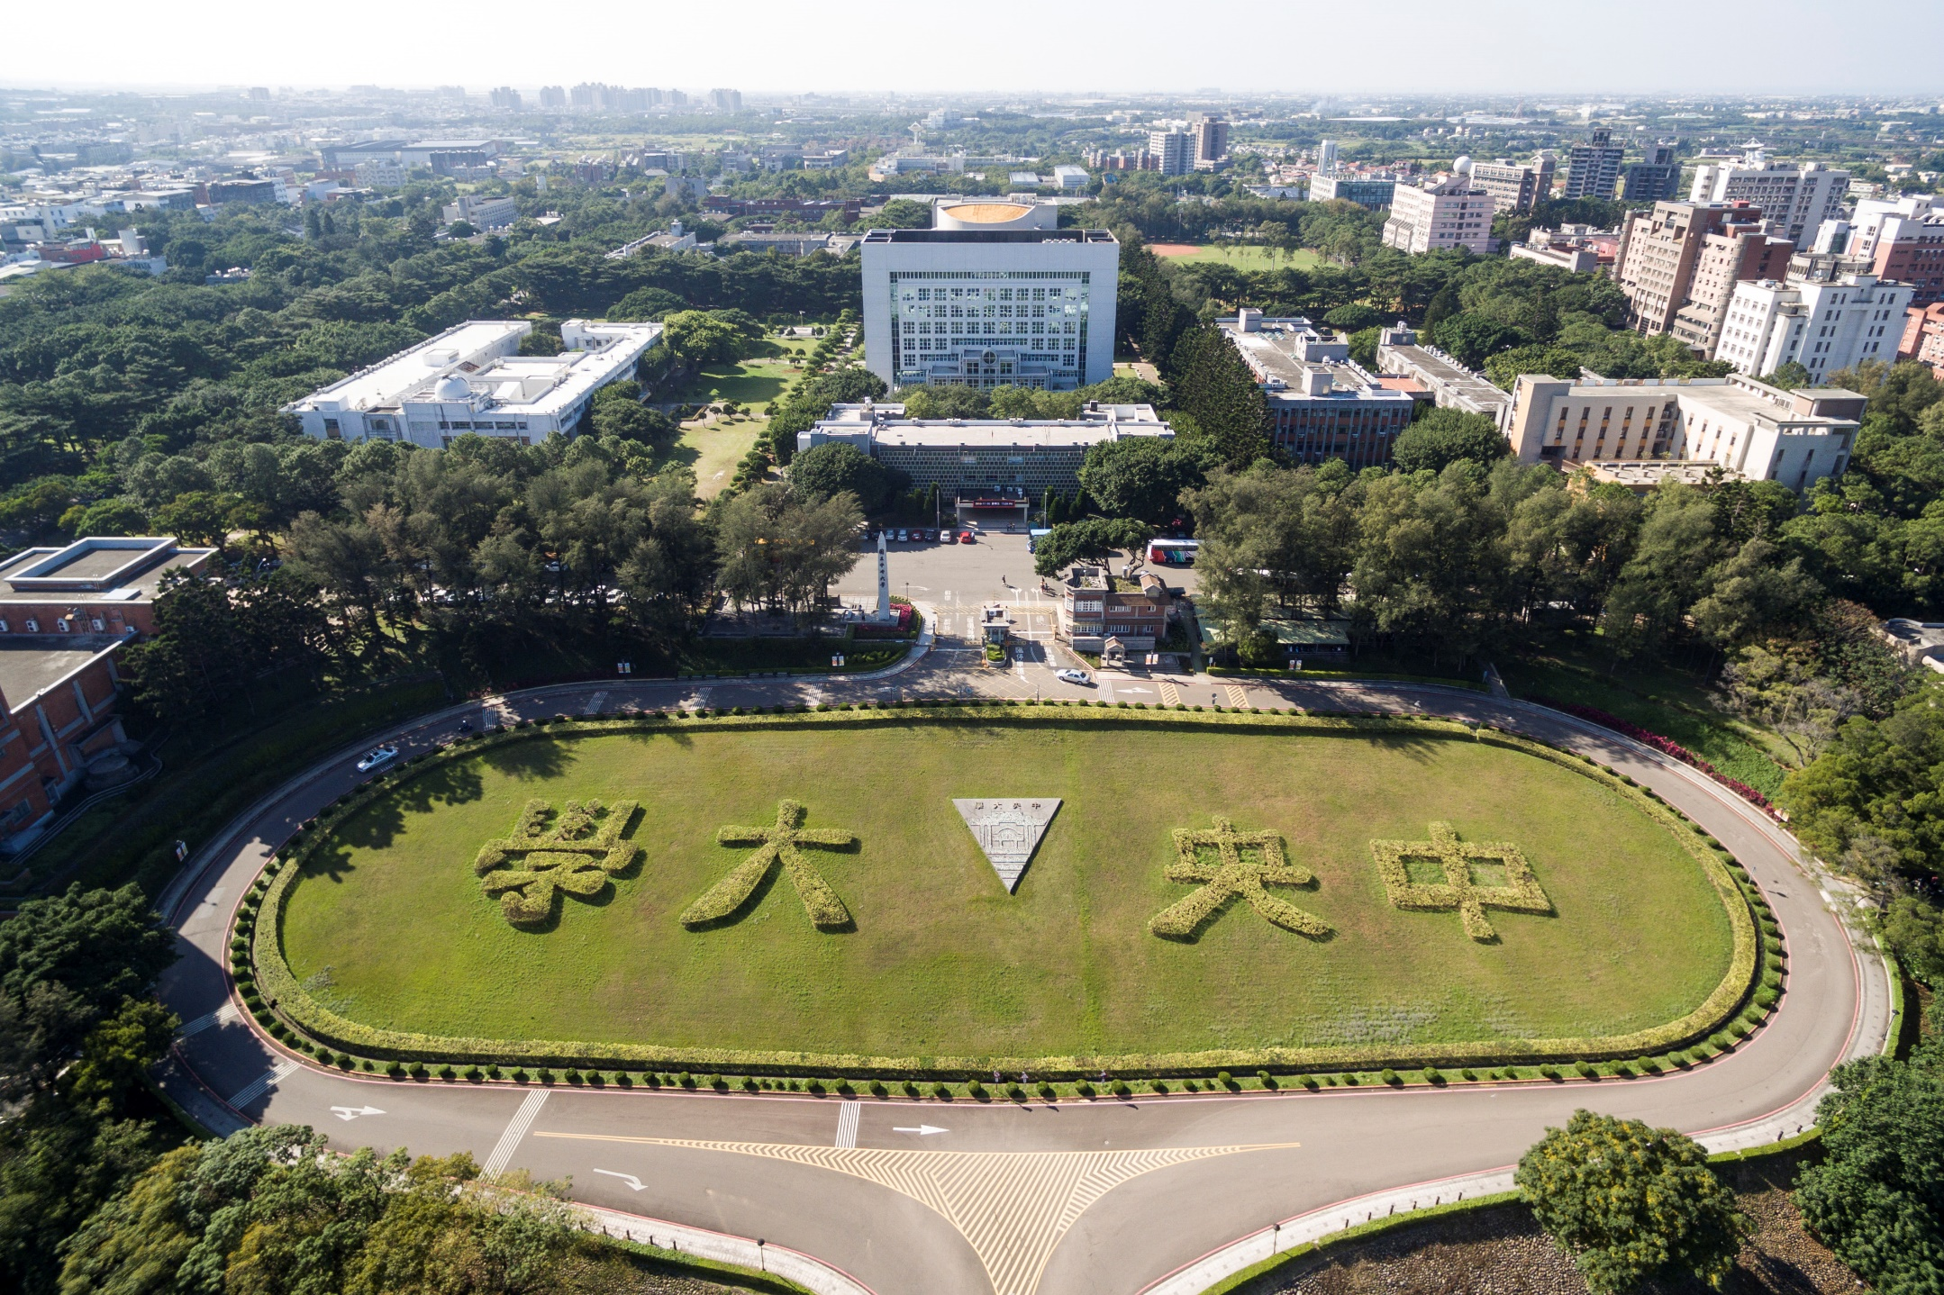
Thank you for your attention

